Slide 1
Analysis of Phylogenies
Part 1: Phylogenetic study design
Part 2: Acquiring and storing material
Part 3: Collecting DNA sequence data
Part 4: Reconstructing phylogenies
Final considerations and conclusions

Slide 2
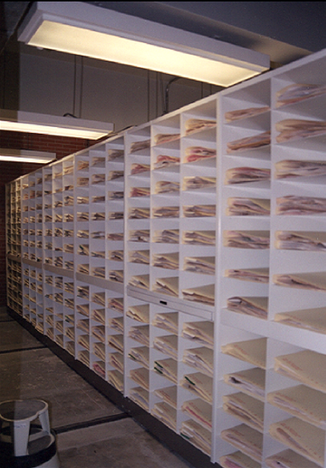
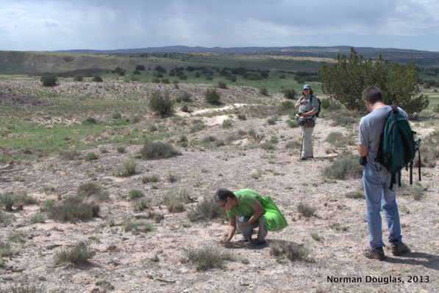
Part 2: Acquiring and storing material
Hilda Flores Olvera

Slide 3
Part 2: Acquiring and storing material
I. Recommendations for field sampling (including for molecular, anatomical, physiology, etc. work)
II. Making voucher specimens, including duplicate specimens and good labelling practices
III. The importance of expert identification
IV. Recommendations for herbarium specimens sampling
V. Best practices for storing and shipping material
VI. Why acquiring and storing material is important?

Slide 4
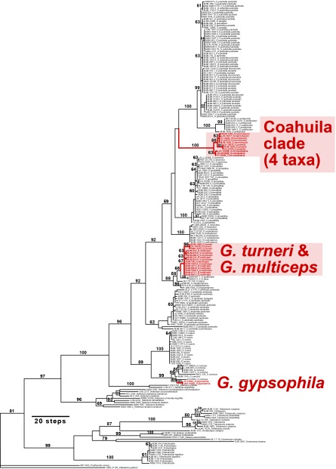
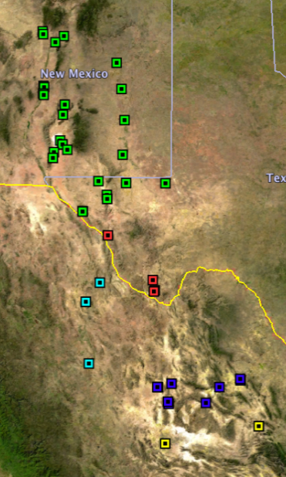
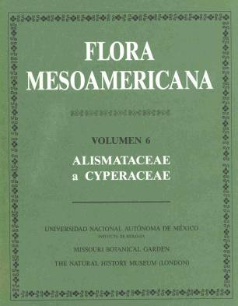
I. Recommendations for field sampling.
Field sampling begins with the research question or hypothesis to be answered.
A. Project planning:
Floristic diversity
Revisions or monographs
Phylogenetic studies (multiple taxa, multiple individuals) etc.) Haplotypes population
Soils
Plant ecology
Anatomical
Citology
Physiology work
…., etc.

Slide 5
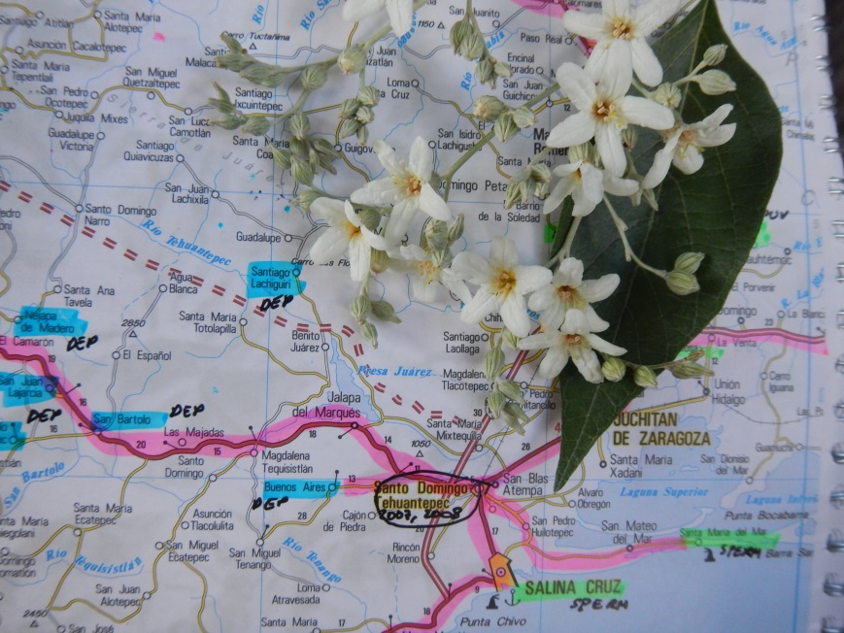
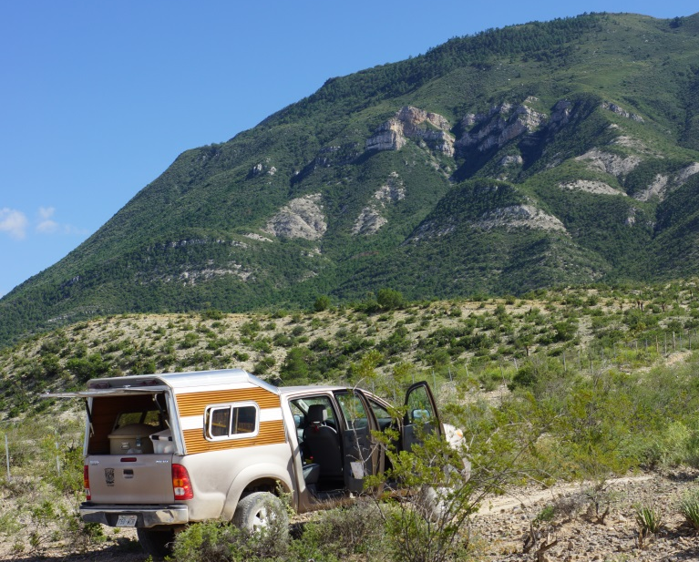
1. Recommendations for field sampling.
B. Field work planning:
Rute
Season
Collaborations
Regional permits

Slide 6
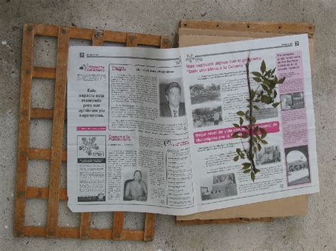
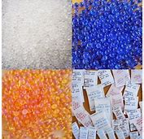
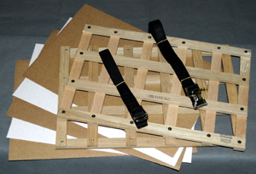
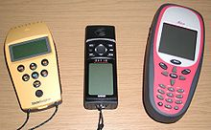
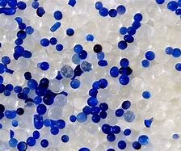
I. Recommendations for field sampling.
C. Material needed
Field tools
GPS
Botanical presses
Molecular. Silica gel and/or liquid nitrogen
Anatomy. Ethilic alcohol
Soils. Drying pans, plastic bags

Slide 7
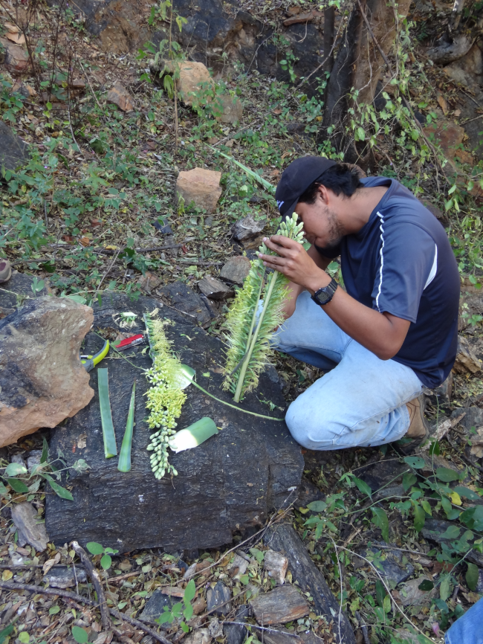
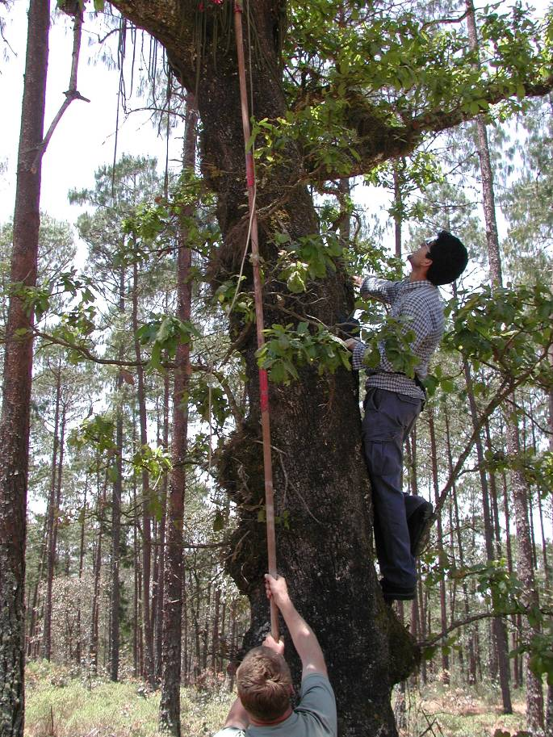
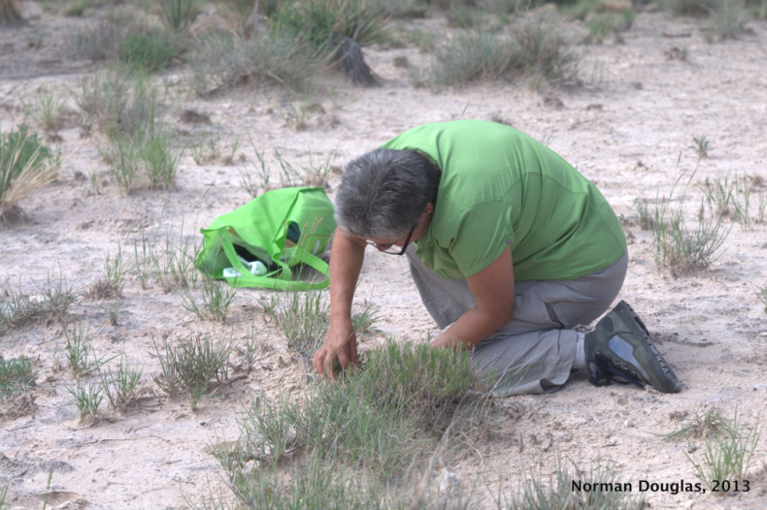
II. Making voucher specimens, including duplicate specimens and
good labelling practices.
Collecting Herbarium specimens. Blossoming branches/fertile plants
with flowers and/fruits
-annuals with roots
-perennials with underground structures
-shrubs and trees with branches

Slide 8
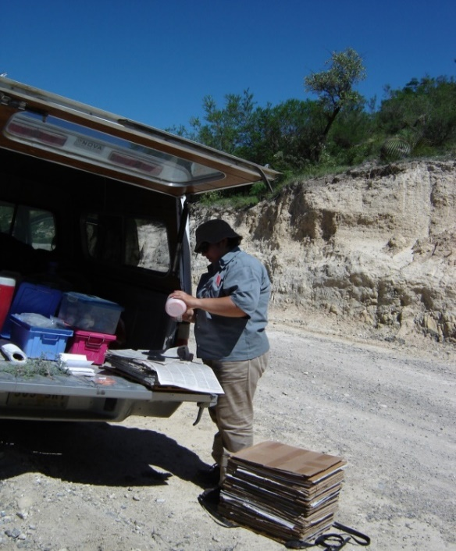
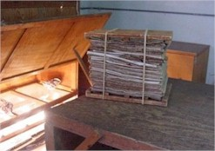
II. Making voucher specimens, including duplicate specimens and
good labelling practices.
B. Collecting tissue for molecular studies.

Slide 9
II. Making voucher specimens, including duplicate specimens and good labelling practices.
C. Field notes:
i. Locality
Country, municipality, point of reference
Geographical coordinates
Habitat characteristics:
Type of vegetation
Soil characteristics
Species asociated
ii. Plant characteristics
Duration
Life form
Size
Flowers/fruits color
iii. Collector´s names and number
iv. DATE

Slide 10
II. Making voucher specimens, including duplicate specimens and good labelling practices.
C. Labelling.
HERBARIO NACIONAL DE MÉXICO
(MEXU)
NYCTAGINACEAE
Anulocaulis reflexus I.M. Johnst.
Det. Michael J. Moore
Mexico. Chihuahua. 28 29 27.4 N -105 03 27.2 W. Elevation 4978 ft.
N end of Sierra de Fernando, on Rancho Puerto de Lobos.
Steep, dissected gypsum exposures. Gypsum flora highly dependent on slope and aspect; E-facing slopes dominated by Selaginella and ferns, W-facing slopes open and dominated by Anulocaulis. Only a handful of gypsum endemic plants present: Anulocaulis cf. reflexus, Nerisyrenia camporum, Nama carnosum, Sartwellia, Tiquilia, Dicranocarpus parviflorus. Conditions excellent.
Herbaceous perennial from occasionally large caudex. Plants almost scapose. Corollas entirely dark rose-pink. Common.
Michael J. Moore 2457, with H. Flores, H. Ochoterena, N. Douglas.
31-Aug-2013

Slide 11
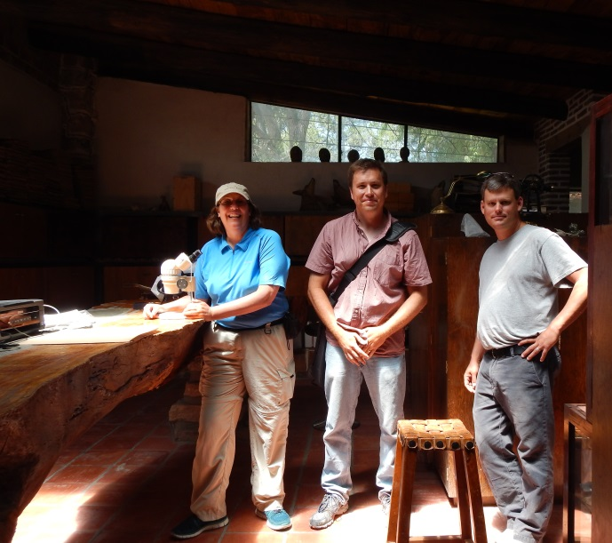
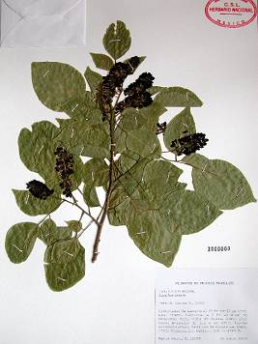
III. Recommendations for herbarium specimens sampling
Leaf material removed for DNA
by Michael J. Moore (OC) Sept. 2017
Evolution of Chihuahuan Desert Gypsophiles

Slide 12
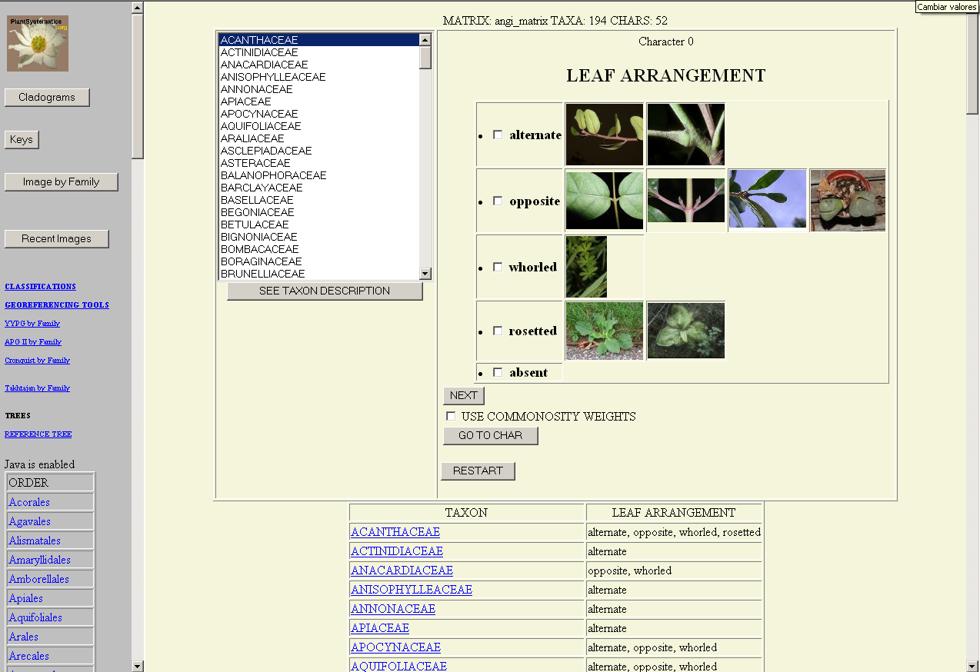
IV. The importance of expert identification.

Slide 13
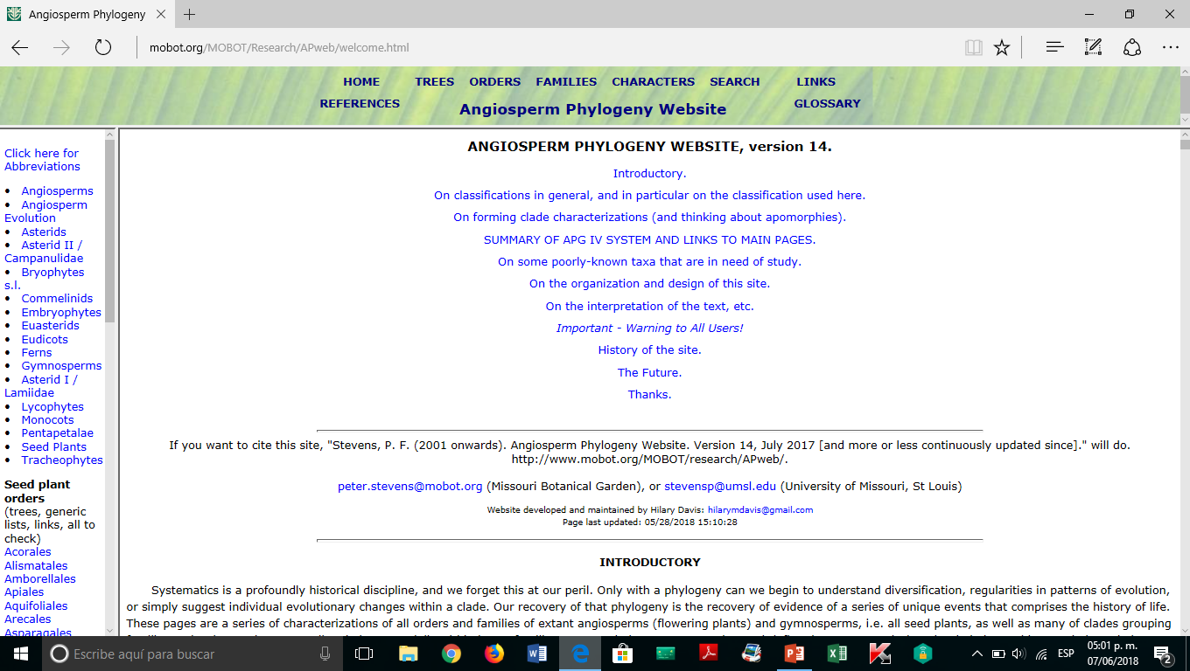
IV. The importance of expert identification.

Slide 14
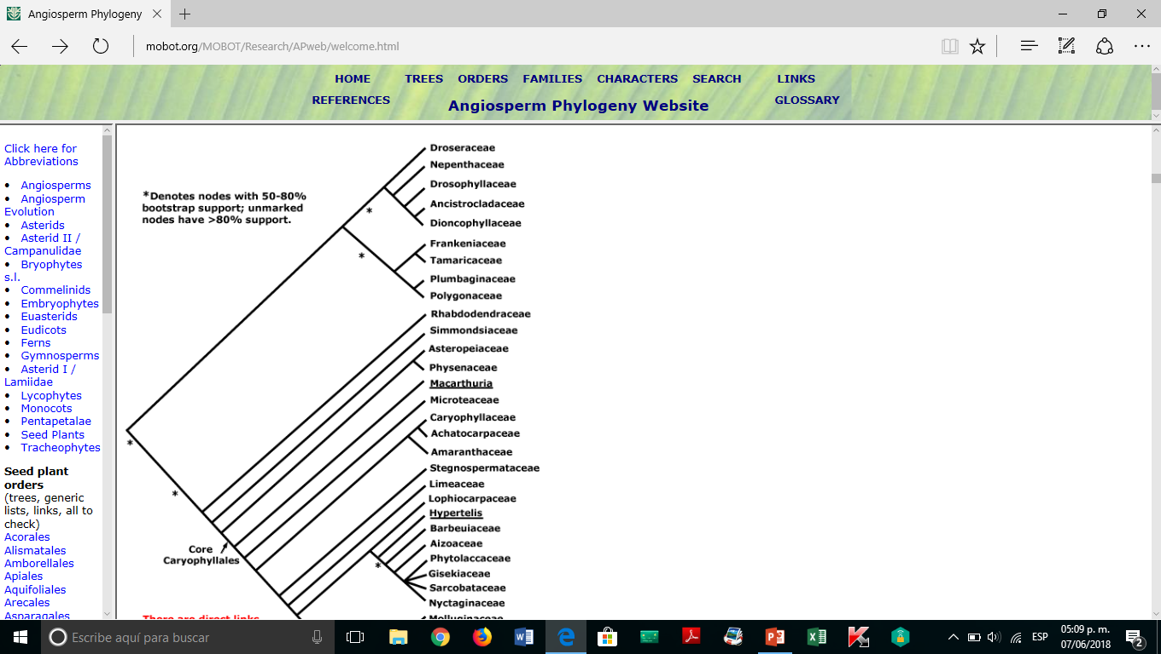
IV. The importance of expert identification.

Slide 15
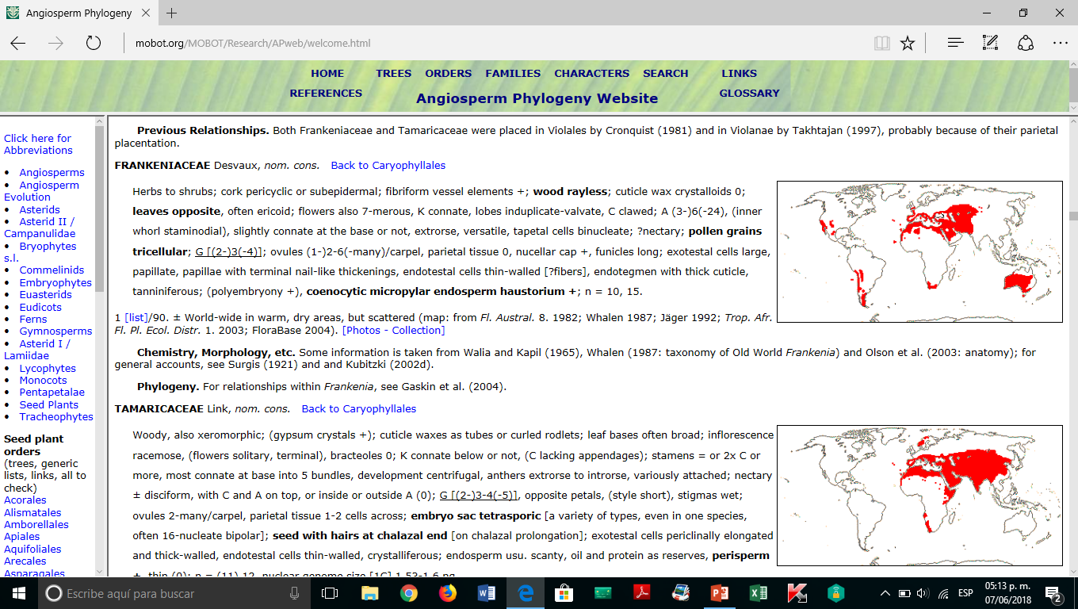
IV. The importance of expert identification.

Slide 16
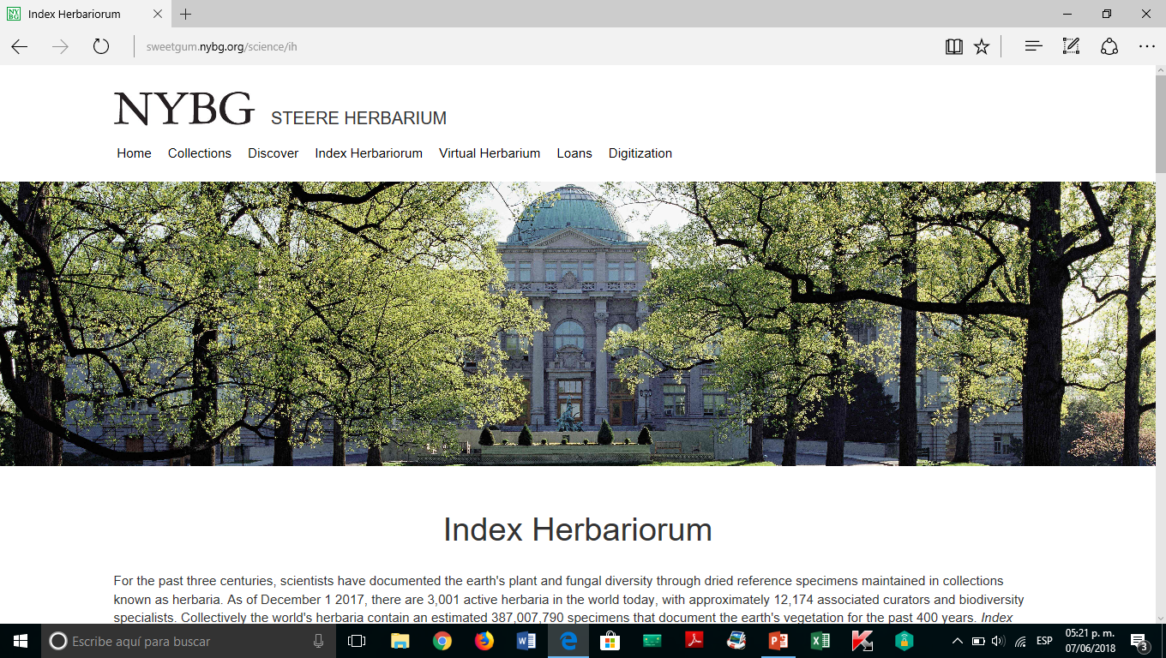
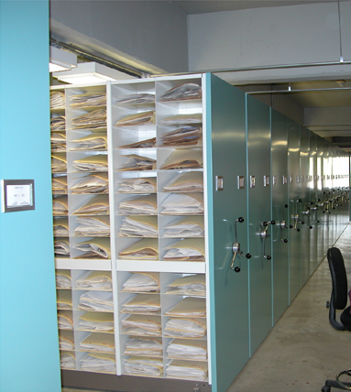
V. Best practices for storing and shipping material

Slide 17
VI. Why acquiring and storing material is important?
BIOLOGICAL DIVERSITY
Discover
Identification
Describe
acquiring and storing material
Naming
Clasification
Understand/explain
AIMS OF TAXONOMY/SISTEMATICS

Slide 18
AIMS OF TAXONOMY/SISTEMATICS
Discover Exploration
Identification Keys
Describe Taxonomic treatments
Naming Communication
Clasification Order
Cladogram Explanation

Slide 19
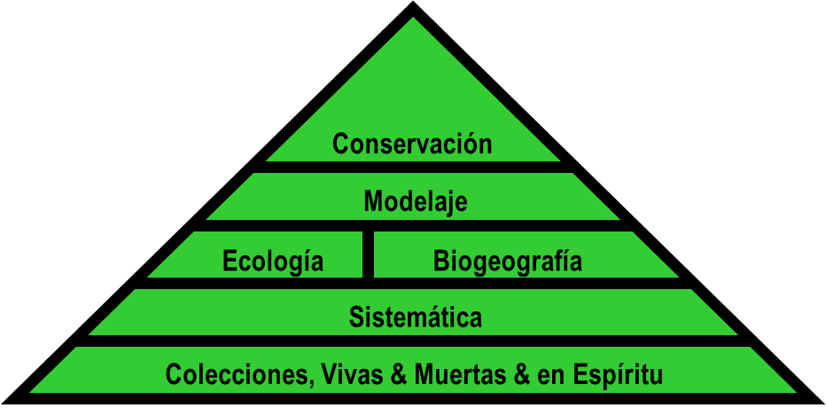
Users dependent on taxonomy
Ecologist
Biogeographers
Conservationists
Decision-makers
Molecular Biologist
Etc.
Conservation
Modeling
Ecology
Biogeography
Floras
Systematics
Collections living, dry , spirit)
Stevenson, 2016

Slide 20
Users dependent on taxonomy
Agriculture
Food security
Plant breeding
Floras
Genes discovery
Evo/Devo
Systematics
Collections, living, dry, spirit
Medical treatments
Drug discovery
Medical test
Chemistry
Systematics
Floras
Medicine
Collections, living, dry, spirit
Stevenson, 2016

